Slide 1
CS 4350: Fundamentals of Software Engineering CS 5500: Foundations of Software Engineering Lesson 5.2 Test-Driven Development
Jon Bell, John Boyland, Mitch Wand
Khoury College of Computer Sciences
© 2021 Jonathan Bell, John Boyland and Mitch Wand. Released under the CC BY-SA license

Slide 2
Learning Objectives for this Lesson
By the end of this lesson, you should be able to:
Define “Test-Driven Development”;
Contrast two different phases for programming in TDD;
Outline the strengths and weaknesses of TDD.

Slide 3
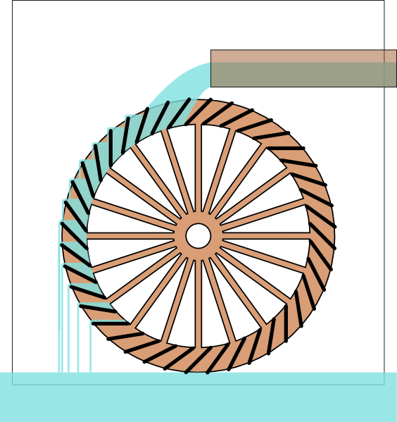
Test-Driven Development (1)
From outside, the development is driven by “issues”:
New feature requests;
Enhancement requests;
Bug reports;
Internal feature requests.
Issues are the “water” in our “TDD = water wheel” metaphor.
Issues

Slide 4
Test-Driven Development (2)
The first task is to write a test.
The test should fail.
A bug report is not actionable until we have replicated it.
A feature request is not actionable until we know what how it should work.
Tests are the “buckets” in our metaphor.
Issues
Write test

Slide 5
Test-Driven Development (3)
Then we fix the code:
Change code until test passes;
All previous tests must pass too (no regression!);
No redesigns; goal is to fix as quickly as possible.
Coding turns the wheel until the “water” is gone (issue is fixed).
Issues
Write test
Fix code

Slide 6
Test-Driven Development (4)
Clean up code:
At leisure, “refactor” code;
Not driven by issues;
No (visible) behavior changes;
All tests must still pass;
Improve maintainability.
Refactoring borrows momentum to turn the wheel without the action of “water.”
Issues
Write test
Refactor
code
More on Refactoring Later!
Fix code

Slide 7
Caveats & Qualifications
Typically, a new feature will require multiple tests
The “fix” should not just be the minimum to pass the test(s)
The programmer should keep in mind the spec/requirements.
But the fix should be the simplest possible that addresses the issue.
Tests are run frequently and thus must be fast and deterministic.
Occasionally, the tests may need to be fixed as well.

Slide 8
Strengths
Goals are concrete and actionable.
We revisit requirements frequently:
We make sure we are building the right product;
Mistakes are fixed earlier.
Separate refactoring stage means code hygiene is not forgotten.
Test portfolio gives confidence in maintenance.

Slide 9
Weaknesses
Often the same person writes the test and implements the code being tested
Blind spots: programmer may overlook something;
Gentleness: programmer may avoid “hard” tests.
Tests can add to maintenance problems
Slow, flaky or brittle tests can slow down ”wheel” (both fixing code and refactoring)
As defined, TDD is perhaps overly strict. (Discuss!)
Flaky and Brittle: See next Lesson!

Slide 10
Variants
Acceptance Test Driven Development (ATDD)
Write “system” tests to express user requirements.
These tests may be “large” and/or “slow”.
Some may not be automatable.
Behavior Test Driven Development (BTDD)
Uses structured natural language to describe user stories with desired behavior.
Also “system” tests.

Slide 11
Review
Now that you've studied this lesson, you should be able to:
Define “Test-Driven Development”;
Contrast two different phases for programming in TDD;
Outline the strengths and weaknesses of TDD.

Slide 12
Looking Forward
In our next lesson, we’ll learn about how to evaluate tests. What makes a test suite good?

